Slide 1
Tables are Not Your Friends: Graph Databases
MIS 64082 – Database Management and Database Analytics
Based on: Next Generation Databases: NoSQL, NewSQL, and Big Data by Guy Harrison, Copyright © 2015 by Guy Harrison
Adaptation - Copyright © 2019 by Alan Brandyberry

Slide 2
Graph Databases
Proponents of key-value stores, document databases, and relational systems agree in one respect: databases are about storing information about “things,” be those things represented by JSON, tables, or binary values.
But sometimes it’s the relationship between things, rather than the things themselves, that are of primary interest.
This is where graph database systems shine.

Slide 3
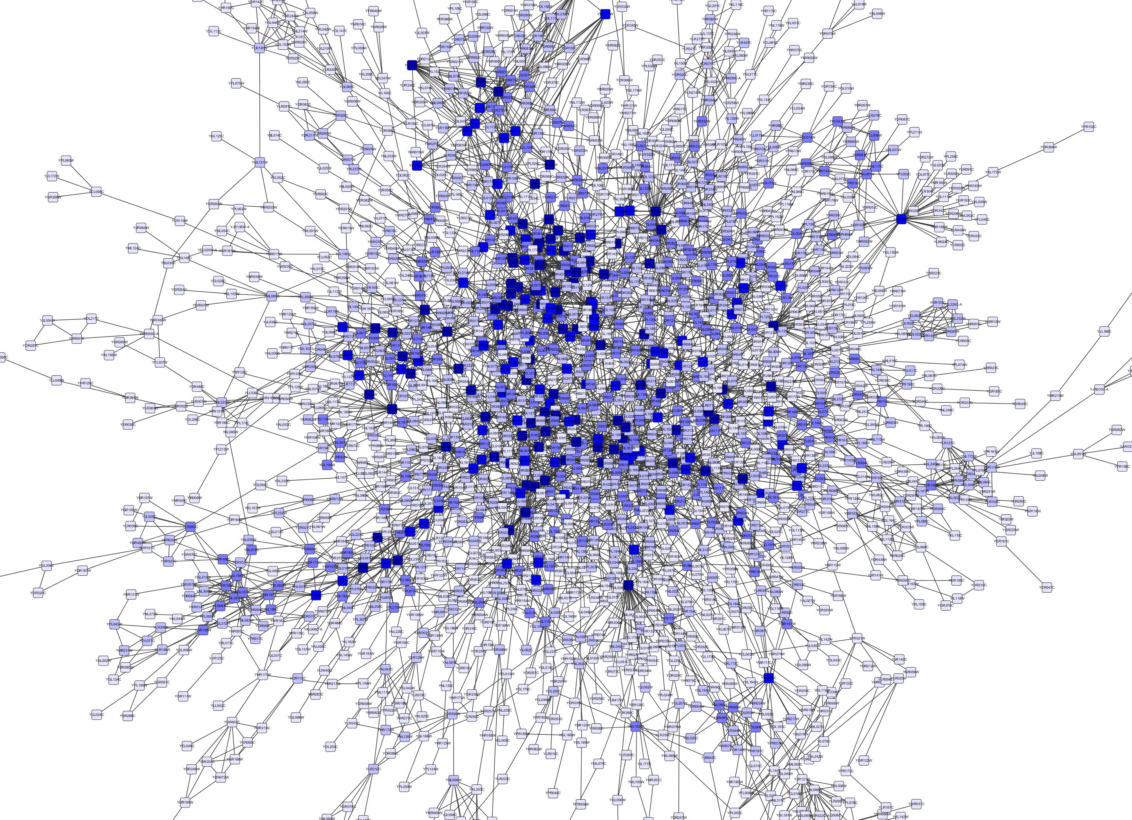
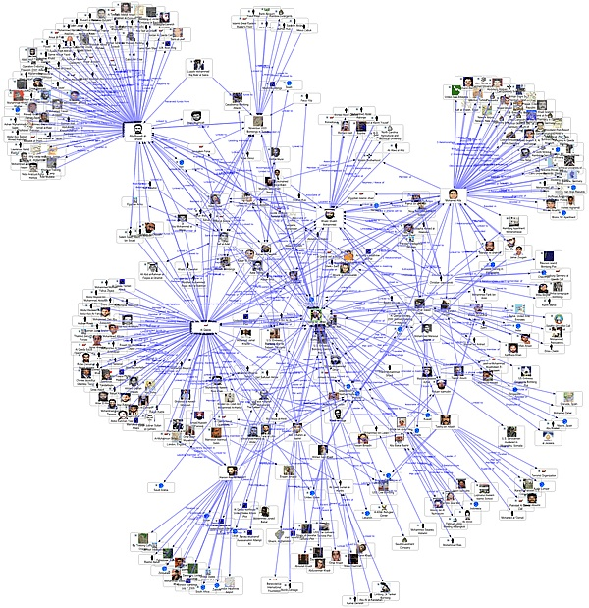
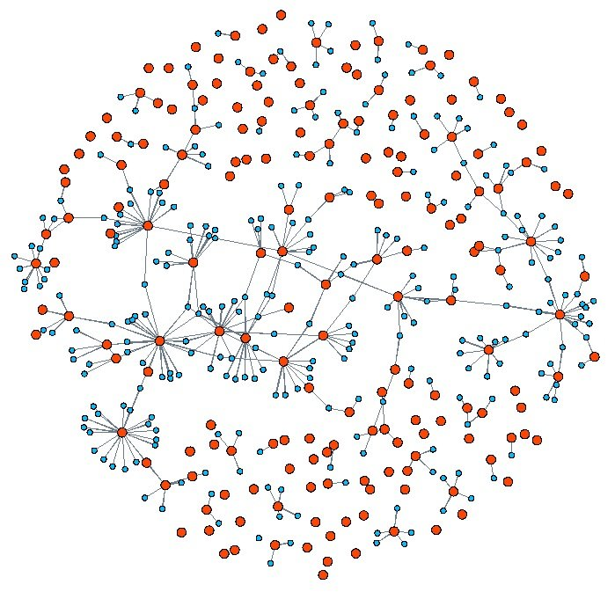
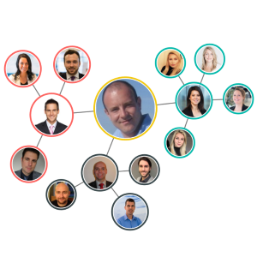
Social Networks

Slide 4
Where are graph databases utilized?
Relational databases are capable of representing these kinds of relationships.
Relational databases have performance issues with large graphs.
Other types of NoSQL databases are generally very poor at representing these relationships since they do not employ joins and auto-joins (recursive) are required.
To efficiently process a data model in which complex networks of relationships between objects or entities are a primary focus, a different type of database is called for: the graph database.
Graph Database Use Cases – Neo4j

Slide 5
What is a Graph? What is Graph Theory?
Graph theory defines these major components of a graph:
Vertices, or “nodes,” represent distinct objects.
Edges, or “relationships” or “arcs,” connect these objects.
Both vertices and edges can have properties.
Graph theory is a long-established branch of mathematics, with many practical applications in medicine, physics, and sociology, as well as in computer science.
Both nodes and relationships can have properties. The properties of nodes are not dissimilar to those you might find associated with a relational table or in a JSON document. Properties of relationships might include the type, strength, or history of the relationship.

Slide 6
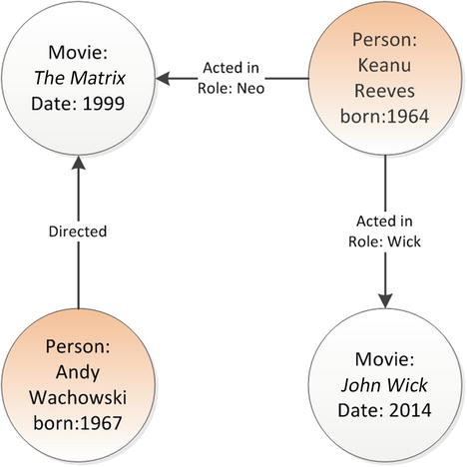
Figure 5-1
Simple graph with four vertices (nodes) and three edges (relationships)

Slide 7
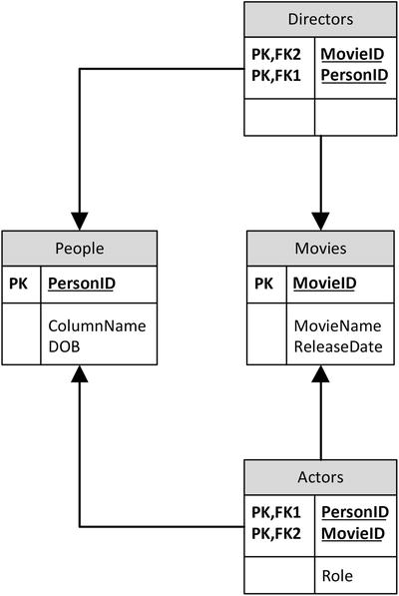
Figure 5-2
Relational schema to represent our sample graph data

Slide 8
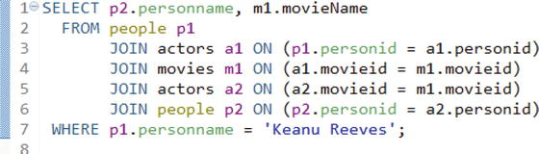
Figure 5-3
SQL to perform first-level graph traversal

Slide 9
Resource Description Framework (RDF)
The Resource Description Framework (RDF) is a web standard developed in the late 1990s for the modeling of web resources and the relationships between them. It represents one of the earliest standards for representing and processing graph data.
Information in RDF is expressed in triples, conceptually of the form: entity: attribute :value
Examples:
TheMatrix: is :Movie
Kenau: is :Person
Kenau: starred in: TheMatrix

Slide 10
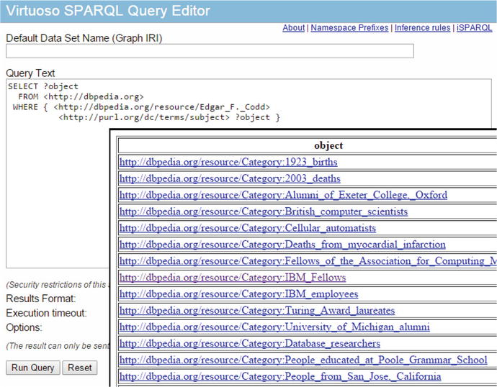
Figure 5-4
Interrogating Dbpedia
using SPARQL
RDF supports a query language SPARQL which is a SQL-like language for interrogating RDF data.

Slide 11
Neo4j
The Property Graph model provides a richer model for representing complex data by associating both nodes and relationships with attributes.
The property graph model is the basis for Neo4j, which is the most widely adopted graph database.
Neo4J is a Java-based graph database that can be easily embedded in any Java application or run as a standalone server. Neo4j supports billions of nodes, ACID compliant transactions, and multiversion consistency.
Neo4j implements a declarative graph query language Cypher. Cypher allows graphs to be queried using simple syntax somewhat comparable to SQL or SPARQL, but particularly optimized for graph traversals.

Slide 12
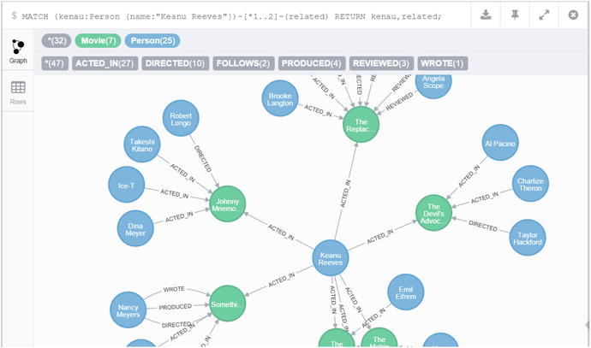
Figure 5-5
Graph output from cypher query

Slide 13
Gremlin
Gremlin is an alternative graph database query language that can be used with Neo4J and a variety of other graph engines, including Titan (now part of the Datastax Cassandra distribution) and OrientDB.
Compared to Cypher’s nonprocedural SQL-like style, Gremlin is a more procedurally oriented language. Using Gremlin, the programmer declares the specific traversal operations to be performed—possibly in multiple statements.

Slide 14
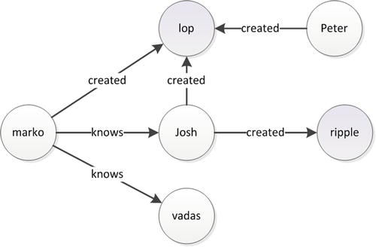
Figure 5-6
Gremlin sample graph database

Slide 15
Graph Compute Engines
Graph compute engines provide a solution for databases that want to merge graph processing with other data models and for graph processing that needs to work across massive distributed datasets.
Significant graph compute engines include:
Apache Giraph: A graph processing system designed to run over Hadoop data using MapReduce.
GraphX: A graph processing system that is part of the Berkeley Data Analytic Stack (BDAS), which includes Spark (see Chapter 7). It uses Spark as the foundation for graph processing just as Giraph uses MapReduce.
Titan: A graph database that can be layered on top of Big Data storage engines, including Hbase and Cassandra. Datastax—the commercial vendor of Cassandra—acquired Auerlius, the commercial sponsor of Titan, in 2014.

